Slide 1

Python Review and Tutorial

Slide 2

Intent of Class
Quick review of Python
Problem-centric
Tailor to needs
Please give feedback on what you would like out of the course
Please give suggestions on other topics to cover
Other languages, specific problems, automation, etc

Slide 3
Overview
Review of Basics
Extending Python
The Pythonic Way
Pandas Data Wrangling
PyODBC Data Base Connector
MatPlotLib Visuals
Scikit-Learn Machine Learning
Automating Python Scripts in Windows
Putting It All Together

Slide 4
Review of Basics
Environments
Basic Properties
Variables
Comments
Collections
Conditionals
Loops
Functions

Slide 5

Environments
Problem
You are given a new project in which you need to get updates on parts that are arriving at your facility. Continually checking for the parts to arrive will waste time, so an automated approach will be beneficial.

Slide 6
Environments
Problem:
How can we offload this workload?
What do we need to set it up?

Slide 7
Environments
How can we offload this workload?
Can’t constantly check for parts to arrive in database.
Can automate a program to check as often as needed.
Perhaps Python can help us …

Slide 8
Environments
What do we need to set it up?
Need application to convert code to machine language
All-in-one packages:
Integrated Development Environments (IDE)
Integrated Scripting Environments (ISE)
Link translation program and debugger, at a minimum

Slide 9
Review of Basics
Environments
IDLE
Included with Python, written in Python
Integrated Development and Learning Environment
https://www.python.org/downloads/

Slide 10
Review of Basics
Environments
Anaconda
Spyder GUI
Iron Python console
IDLE console
Includes many packages
https://www.anaconda.com/distribution/#download-section

Slide 11
Review of Basics
Environments
Others
Plugins for Visual Studio
PyCharm
Jupyter
Server based – can run online
Coursera runs this

Slide 12
Review of Basics
Problem
I have one of these new fangled IDE’s, but I have no idea how to use it.
How do I use the IDE?

Slide 13

Review of Basics
How do I use the IDE?
In this course, I will be using the Spyder IDE found in the Anaconda package

Slide 14
Review of Basics
How do I use the IDE?
Feel free to use an IDE that you are comfortable with. See previous slides for other IDE ideas.

Slide 15
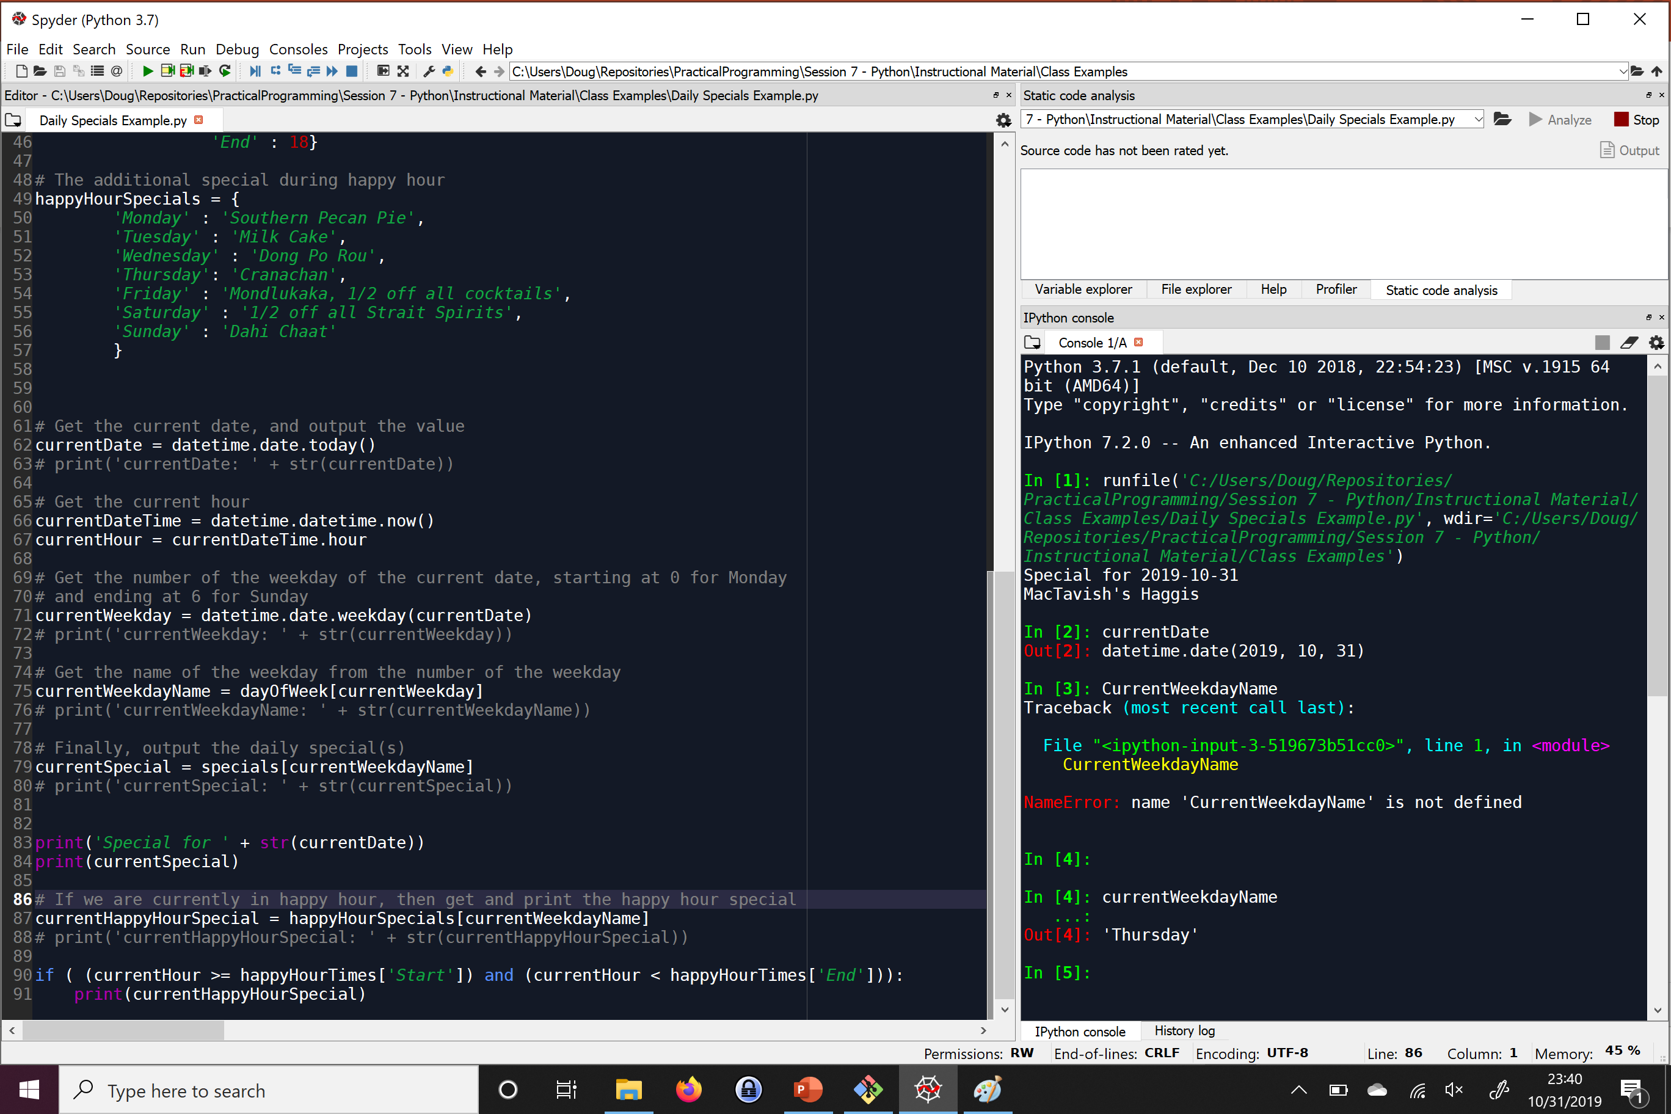
Review of Basics
Script Window – Write entire programs here
Spyder

Slide 16
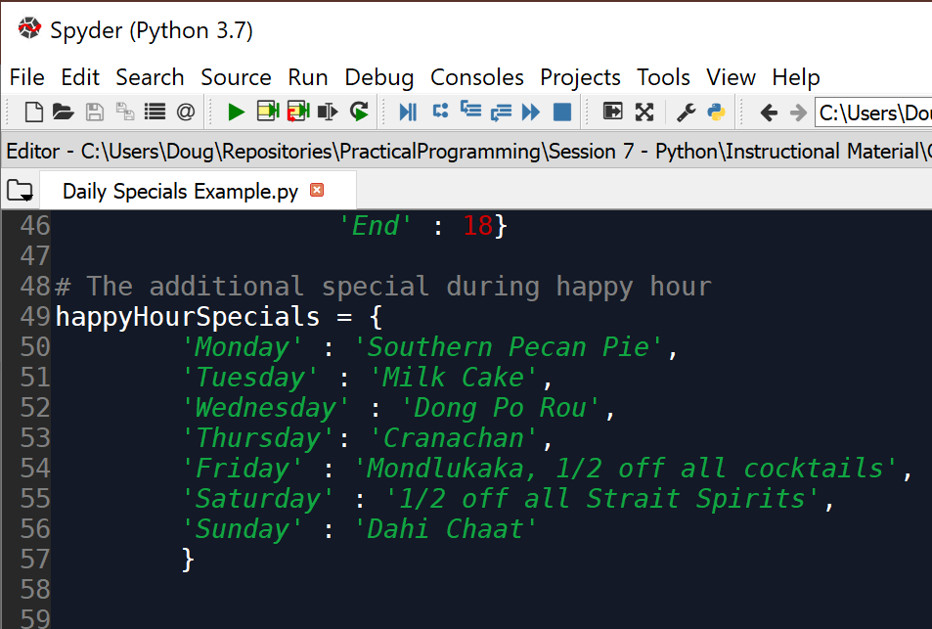
Review of Basics
Run Button - Press this button to run completed scripts
Spyder

Slide 17
Review of Basics
Terminal – Write real-time code here, and see code execution outputs here
Spyder

Slide 18
Basic Properties
Basic Properties of Python
Problem:
I need to get up and running quickly, as well as be able to write programs quickly without understanding a lot of computer science.
I still want control over my programs and how they run, not just to tell the program what data to get.
Will Python support these needs?
Notes:
Things to keep in the back of your mind for now.
Will help more when we get into other programming languages, like SQL

Slide 19
Basic Properties
Basic Properties of Python
Compiled or Interpreted: Interpreted
Can also be compiled
Can better check data in real time
Typing discipline:
Duck-typed
Dynamic
Easier to switch data types on-the-fly
Declarative or Imperative: Imperative Language
Allows us to tell the program how do to what we need it to do
Notes:
Things to keep in the back of your mind for now.
Will help more when we get into other programming languages, like SQL

Slide 20
Primitive Variables
Primitive Variables
I need a way to store data in my program without having to analyze memory in the computer.
I need a way to be able to change data that is stored.
I need to be able to store different types of data in a way that will minimize data comprehension errors by the computer.
I also need a way for the computer to be able to tell me when I am doing something with a type of data that I should not be doing.
Notes:
Called float because it is a floating point. Example: output x=32984328947213.21934782391472193874239847293184

Slide 21
Primitive Variables
Problems
How can I get around the tedious and complex process of managing memory for my application?
How can I change the data stored in my program?
What will prevent Python from performing incorrect operations on different types of data?
Notes:
Called float because it is a floating point. Example: output x=32984328947213.21934782391472193874239847293184

Slide 22
Primitive Variables
How can I get around the tedious and complex process of managing memory for my application?
How can I change the data stored in my program?
Variables
X=5
Employee=‘Jesse’
Notes:
Called float because it is a floating point. Example: output x=32984328947213.21934782391472193874239847293184

Slide 23
Primitive Variables
In-class exercise:
Create a variable that holds a customer name
Rewrite the value in the variable
Notes:
Called float because it is a floating point. Example: output x=32984328947213.21934782391472193874239847293184

Slide 24
Review of Basics
Primitive Variables
What will prevent Python from performing incorrect operations on different types of data?
Datatypes
Notes:
Called float because it is a floating point. Example: output x=32984328947213.21934782391472193874239847293184

Slide 25
Review of Basics
Primitive Variables
Integers
Whole numbers
Exact values
Int_val = 5
Notes:
Called float because it is a floating point. Example: output x=32984328947213.21934782391472193874239847293184

Slide 26
Review of Basics
Primitive Variables
Float
Decimal values
Approximate values
Float_val = 2.5
Notes:
Called float because it is a floating point. Example: output x=32984328947213.21934782391472193874239847293184

Slide 27
Review of Basics
Primitive Variables
Strings
Characters, text storage, and limited markup storage
String_val = “this is a string, friend”
string_val = ‘this is also a string, friend’
Notes:
Called float because it is a floating point. Example: output x=32984328947213.21934782391472193874239847293184

Slide 28
Review of Basics
Primitive Variables
Booleans
Yes or no values
True or false values
bool_true_val = True
bool_false_val = False
Notes:
Called float because it is a floating point. Example: output x=32984328947213.21934782391472193874239847293184

Slide 29
Review of Basics
Primitive Variables
Datatype tells what operations are permissible
‘+’ Operator adds numeric data types
‘+’ Operator concatenates strings
In-class exercise:
Add two numbers together
Concatenate two strings together
Add a number and a string together
Notes:
Called float because it is a floating point. Example: output x=32984328947213.21934782391472193874239847293184

Slide 30
Review of Basics
Variables
Problem:
When I try and add a string that is definitely a number to a number, I still get an error. The string is ‘5’, so I know it should be a number, but Python doesn’t understand this
How can I check what a variable’s current data type is?
How can I get Python to understand a certain datatype should actually be something else?
Notes:
Variables store values. Variables let us not worry about memory management. Variables can change.

Slide 31

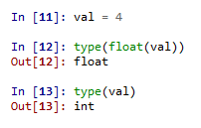
Review of Basics
Variables
Getting the type
type() function
Conversions
type name, followed by value to convert in parenthesis
float(int_val)
str(double_val)
Notes:
Variables store values. Variables let us not worry about memory management. Variables can change.

Slide 32
Review of Basics
Variables
In-class exercise:
Give the following variables:
Make sure you know what the datatypes are
Mathematically add them
current_engine_hours = 147
next_reported_hours = ‘3’
Notes:
Variables store values. Variables let us not worry about memory management. Variables can change.

Slide 33

Review of Basics
Review
Integrated Development Environments
Variables
Datatypes
Conversions
Notes:
Variables store values. Variables let us not worry about memory management. Variables can change.

Slide 34
Review of Basics
Comments
Problem:
I understand what code I have written, but I am not sure I will understand later. I am also not sure if my teammates will understand what the code is doing if they need to work on the same code.
How can I explain or annotate my code without the computer thinking I am giving it commands?

Slide 35
Review of Basics
Comments
#
Single-line comment
“”” “”” or ‘’’ ‘’’
Designed for documentation sections
Can work as a block-style comment for testing

Slide 36
Review of Basics
Collections
Problem:
Single values in variables in usually useful, but sometimes I need to represent multiple values of data that belong to the same thing, such as the day names in a week, without wanting to create a separate variable for each value.
How can I store multiple values in one variable?

Slide 37
Review of Basics
Collections
How can I store multiple values in one variable?
Tuple
List

Slide 38
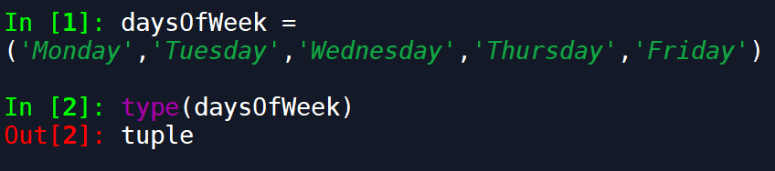
Review of Basics
Collections
tuple
Tuple is mathematical set of numbers
Set and access elements with ()
Analogous to array, value-type collection
Can mix value data types

Slide 39
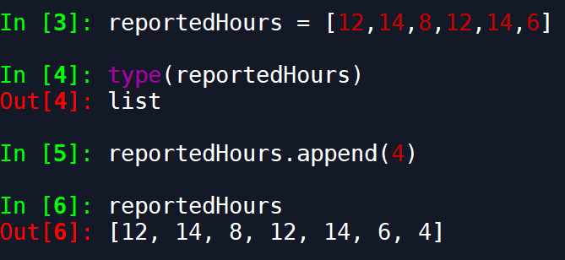
Review of Basics
Collections
list
Holds multiple values that can change
Set and access elements with []
Reference-type collection
Can mix value data types

Slide 40
Review of Basics
Collections
Problem:
The datatypes that house multiple values are nice, but I would like a way to still give a name for my data. For instance, maybe I want to keep track of all of my funds across multiple accounts, or perhaps I want to store my restaurant’s specials for each day of the week.
How can I create a key-value pair of data that is stored in a single datatype?

Slide 41
Review of Basics
Collections
How can I create a key-value pair of data that is stored in a single datatype?
dictionary

Slide 42
Review of Basics
Collections
dictionary
Hash table, name:value pair
Set with {}
Access elements with []
Very fast at loading values
Further reading: https://stackoverflow.com/questions/327311/how-are-pythons-built-in-dictionaries-implemented

Slide 43
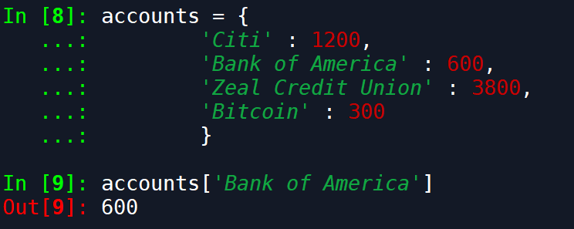
Review of Basics
Collections
dictionary

Slide 44
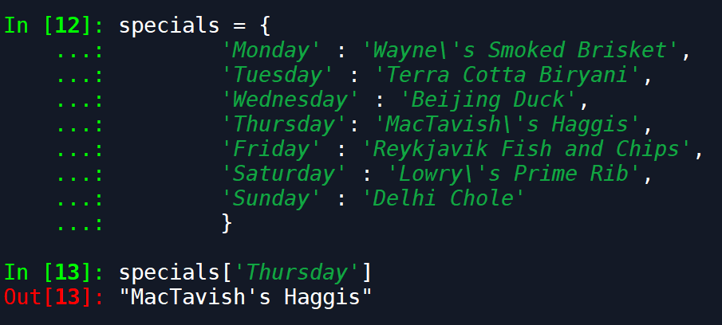
Review of Basics
Collections
dictionary

Slide 45

Review of Basics
Class Exercise:
Create a list of at least 5 foods
Create a tuple/an array of constant values (like days in the year, approximate value of pi, etc)
Create a dictionary of state abbreviations and names
Create a list of dictionaries

Slide 46
Review of Basics
Conditionals
Problem:
I have a happy hour for my restaurant with an a second special in addition to the daily special. I need my computer to be able to decide which day it is, if it is happy hour, and what specials to display.
How do I get the computer to make decisions?

Slide 47

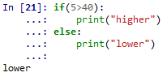
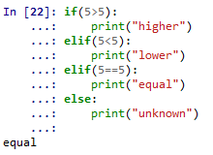
Review of Basics
Conditionals
if
if-else
if-elif
if-elif-else
switch
Not implemented, must use dictionaries in a function
Why did we do this?

Slide 48
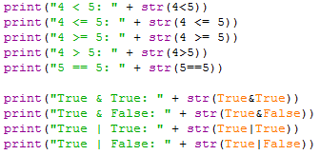
Review of Basics
Conditionals
Logical operators examples
Notes:
Data types must match for equality to return true

Slide 49
Review of Basics
Conditionals Class Example
Example code ‘Daily Specials Example.py’

Slide 50
Review of Basics
Conditionals Class Exercise
Write code to compare two variables:
One containing an integer number
One variable containing a string number
For instance, ’10’ > 5 should be True.

Slide 51
Review of Basics
Review
Collections
Tuple/Array
List
Dictionary
Conditionals
Used to make decisions/comparisons
Additional conditionals in ./Instructional Material/Class Examples/ConditionalStatements.py

Slide 52
Review of Basics
Loops
Problem:
I have written some code, but now I need to apply it to a large number of values in a list.
I need to find if a specific condition exists, but I do not know how many values I need to check
How can I apply the same section of code to a large number of values without rewriting the code?
How can I iterate over values checking a condition when I don’t know how many values I need to check?

Slide 53
Review of Basics
Loops
How can I apply the same section of code to a large number of values without rewriting the code?
for loop
Loops through each element in a collection
Use range() to get a quick list of elements

Slide 54
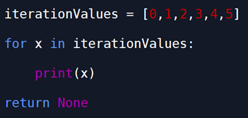
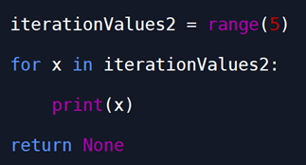
Review of Basics
Loops

Slide 55
Review of Basics
Loops
How can I iterate over values checking a condition when I don’t know how many values I need to check?
while loop
See next slide

Slide 56
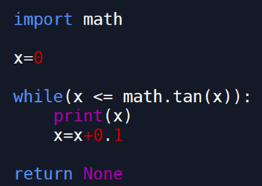
Review of Basics

Slide 57
Review of Basics
Loops
Loop examples:
./Instructional Material/Class Examples/Loop Examples.py

Slide 58
Review of Basics
Loops
In-class exercises:
Create a list of the days of the week, and print each day using a loop
Create a loop that counts from 0 -100, and prints all even numbers

Slide 59
Review of Basics
Loops
Real-world example:
Waiting for a part to show up in stores
./Instructional Material/Class Examples/Real World Loop Example/Listener.py

Slide 60
Review of Basics
Loops
Real-world example problem:
I have been given a list of project profits, and I need to check if any of them are below zero.

Slide 61
Review of Basics
Loops
Real-world example problem:
I have the times of my employees, and I need to check if they have worked overtime this week or not.

Slide 62
Review of Basics
Loops
Real-world example problem:
I have a set of parts in the repair process with the need-by times and average repair times. I need to check if any of them are over-due, or are projected to not be repaired in time.

Slide 63
Review of Basics
Datetime Library Side Notes
Library allows working with dates, times, and datetimes
Introduces datetime datatype-combination of date and time
Introduces date datatype, which consists of just dates
Conversions between date, datetime and other datatypes
Arithmetic manipulation of datetimes

Slide 64
Review of Basics
Datetime Library Side Notes
Tokens for specifying strings in string to datetime conversions:
https://docs.python.org/3/library/datetime.html#strftime-strptime-behavior

Slide 65
Review of Basics
Datetime Library Side Notes
Directive/Token | Meaning | Example
%d | Day of the month as a zero-padded decimal number. | 01, 02, …, 31
%b | Month as locale’s abbreviated name. | Jan, Feb, …, Dec (en_US);
 |  | Jan, Feb, …, Dez (de_DE)
%B | Month as locale’s full name. | January, February, …, December (en_US);
 |  | Januar, Februar, …, Dezember (de_DE)
%m | Month as a zero-padded decimal number. | 01, 02, …, 12
%y | Year without century as a zero-padded decimal number. | 00, 01, …, 99
%Y | Year with century as a decimal number. | 0001, 0002, …, 2013, 2014, …, 9998, 9999

Slide 66
Review of Basics
Datetime Library Side Notes
Directive | Meaning | Example
%H | Hour (24-hour clock) as a zero-padded decimal number. | 00, 01, …, 23
%I | Hour (12-hour clock) as a zero-padded decimal number. | 01, 02, …, 12
%p | Locale’s equivalent of either AM or PM. | AM, PM (en_US);
 |  | am, pm (de_DE)
%M | Minute as a zero-padded decimal number. | 00, 01, …, 59
%S | Second as a zero-padded decimal number. | 00, 01, …, 59
%% | A literal '%' character. | %

Slide 67
Review of Basics
Datetime Library Side Notes
See example script “Datetime Tutorial.py

Slide 68
Review
Review
Loops
Used to run a block of code multiple times
Types:
for
Iterates through a collection
while
Iterates until a condition is met

Slide 69
Review
Review
DateTime Library
Holds dates, times, and datetimes
Arithmetic with datetime objects
Key functions thus far:
strptime() → Get datetime from string
strftime() → Get string from datetime
timedelta() → datetime arithmetic
Drawback: timedelta() only has periods up to a week
Averaging issues converting smaller time periods

Slide 70
Review
Review
DateUtil Library
Similar to DateTime library
Compatible with DateTime objects
Strength: Periods of time > week
relativedelta() → equivalent of timedelta()
Can use time periods up to a year

Slide 71
Open File Preview
Open
Used to open a file
Need path to file
Need file “mode”
Outputs file handle
Preferred way to use is with “with” statement
See “.\Class Examples\File Access Examples\File Access Tutorial.py”

Slide 72
Functions
Up to this point:
Bare necessities of programming covered
The rest is convenience and efficiency

Slide 73
Functions
Covered:
Data storage
Data types
Labeled data
Collections
Data manipulation
Iterating through values, or until condition is met
Decision making/branching
Manipulating files

Slide 74
Functions
Covered:
Even covered some extra libraries

Slide 75
Functions
Functions
I have some code that I have written that can be used in multiple locations of my application if I just change one little part.
Is there a way to utilize this one piece of code without writing it over and over again?
I have the same piece of code in many places, but we are still developing the code—changes are likely.
Is there a way I can write this piece of code just once, so I can change the code in one place versus a million?

Slide 76
Functions
Functions
My code is getting really complex. I have hundreds of lines of code, and I don’t remember what everything does. It is also getting hard to test, because I do not know the overarching, high-level ideas of the code.
Is there a way I can categorize certain sections of code, so that I can understand the high level ideas of sections of code without having to understand all the little details?

Slide 77
Functions
Functions
Can help in all these cases
Functions create a named, reusable section of code

Slide 78
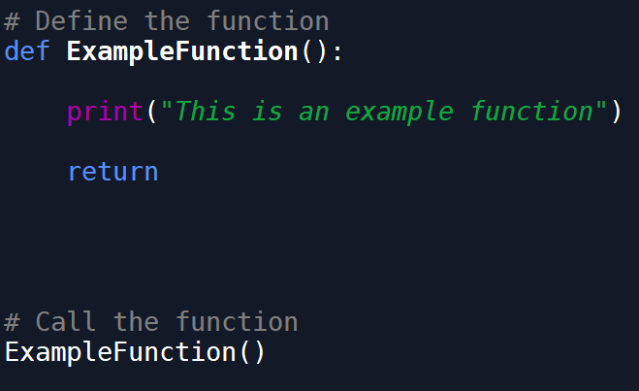
Functions
Functions

Slide 79
Functions
Functions
Defining the function:
def <function_name>(parameter_list):
<body of function>
return <optional_return_val>
Calling the function:
<function_name>(<argument_list>)

Slide 80
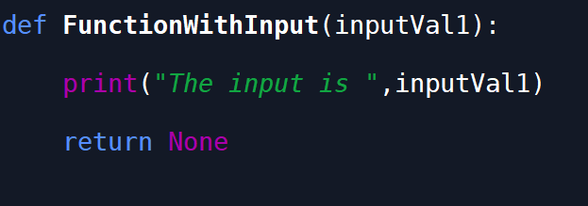
Functions
Functions
Functions can have inputs

Slide 81
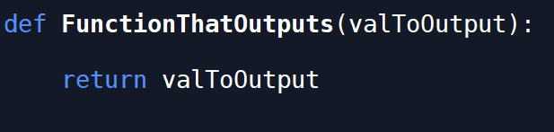
Functions
Functions
Functions can have outputs

Slide 82
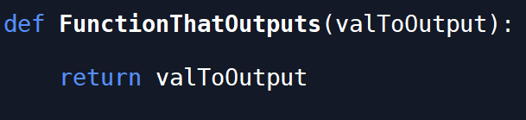
Functions
Functions
Functions do not have to have code in them
Can be used as a place holder for future code
Helps plan out what needs done

Slide 83
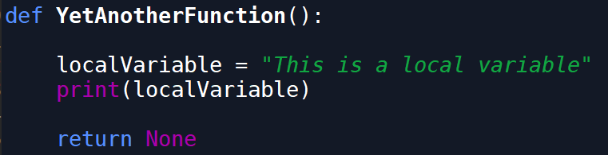
Functions
Functions
Allow local, temporary variables to be utilized
Deleted once the function has been used

Slide 84
Functions
Scope
Tells what variables and objects are available in what section of code
In general:
Global scope
Local scope
More later

Slide 85
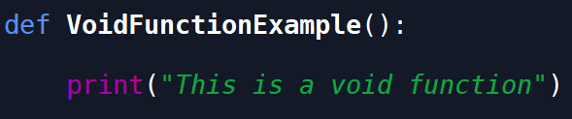
Functions
Functions
Void Functions
Returns nothing (None in python)
Function still does something

Slide 86
Functions
Functions
Example function ./Instructional Material/Class Examples/Example Functions.py

Slide 87
Functions
Functions
Is there a way to utilize this one piece of code without writing it over and over again?

Slide 88
Functions
Functions
Without functions, lots of duplicate code
In-class example: ./Class Examples/Function Examples - Get Largest Value Without Function.py

Slide 89
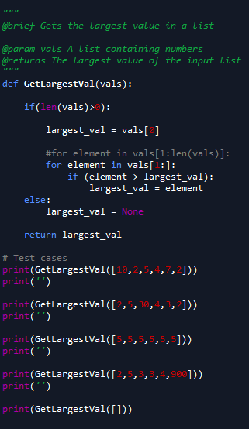
Functions
Functions

Slide 90

Functions
Functions

Slide 91
Functions
Functions
Is there a way I can write this piece of code just once, so I can change the code in one place versus a million?

Slide 92
Functions
Functions
Is there a way I can categorize certain sections of code, so that I can understand the high level ideas of sections of code without having to understand all the little details?

Slide 93
Functions
Functions
Guess what the code does on the next slide (Google is allowed)

Slide 94
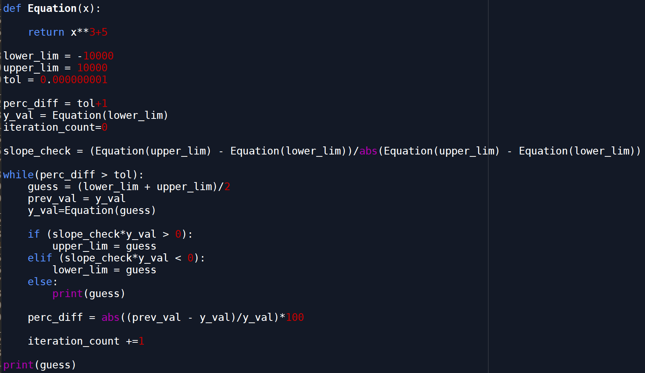
Functions
Functions

Slide 95
Functions
Functions
How about now?

Slide 96
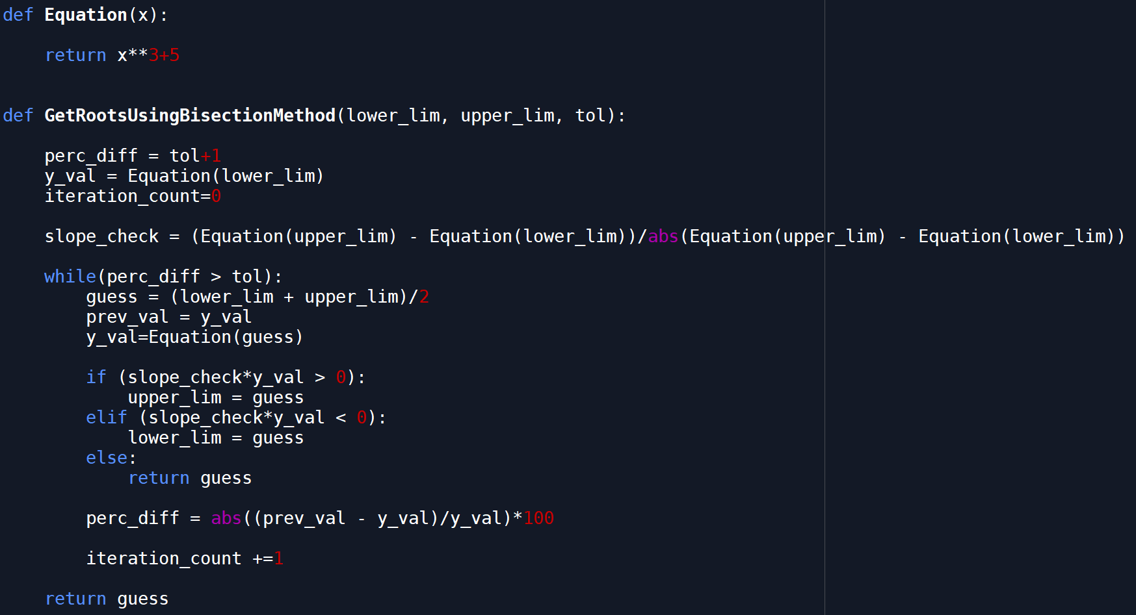
Functions
Functions

Slide 97
Functions
Functions
Review of function code thus far can be found in the files at ./Class Examples/Example Functions.py

Slide 98
Functions
Quick review examples
What is a function?
Define function
Call function
Function with inputs
Function with return value
Void functions

Slide 99
Functions
Functions Class Exercises
Create a function that will return a number
Create a function with two inputs
Create a function with two string inputs, that returns the two strings combined together separated by a space.
I.e. func(“string_1”,”string_2”) == “string_1 string_2”

Slide 100
Functions
Functions Class Exercises
Create a function with an input of a list of integers. The output is a list, with each value squared. The function must contain a loop or a list comprehension.
Create a function that concatenates all of the elements in a list of strings, separated by a space. Utilize two functions for this problem, one of them being the function from exercise (3).

Slide 101
Bookmark

Slide 102
Working with Files
Working with Files
Problem:
I know how to write code, and I can hardcode my own data into a script, but I usually have data stored in some file that I need to work with.
How do I access data from files?
What files can Python access with open() or with?

Slide 103
Working with Files
Working with Files
How do I access data from files?
open Command
open(filepath,mode)
fileHandle = open(filePath,mode=“mode”)
Requires file to manually be closed
Not preferred method
close() command
fileHandle.close()

Slide 104
Working with Files
Working with Files
How do I access data from files?
with statement
with open(filepath,mode) as file:
Using ‘with’ automatically closes file:
After code block finishes executing
Exceptions
Kernel closures
Preferred method

Slide 105
Working with Files
Working with Files
File Access Modes
Character/Token | Meaning
'r' | open for reading (default)
'w' | open for writing, truncating the file first
'x' | open for exclusive creation, failing if the file already exists
'a' | open for writing, appending to the end of the file if it exists
'b' | binary mode
't' | text mode (default)
'+' | open for updating (reading and writing)

Slide 106
Working with Files
Working with Files
What files can Python access with open() or with?
Any text file
How to tell if the file is a text file?
Try opening file with notepad, or other text editor
File should be human-readable
File extension does not necessarily indicate file type

Slide 107
Working with Files
Working with Files
What files can Python access with open() or with?
Common file extension examples:
.txt
.csv
.tsv
.xml
.log
.ini

Slide 108
Working with Files
Working with Files
What files can Python access with open() or with?
Common programming file extension examples:
.py
.c
.cpp
.html
.css
.js
.php
.sql
.bat
.ps1
.sh

Slide 109
Working with Files
Working with Files
Examples at
./Instructional Material/Class Examples/File Access Examples/File Access Examples.py
./Instructional Material/Class Examples/File Access Examples/File Read and Write Examples.py

Slide 110
Working with Files
Working with Files
Additional Notes
Using with statement will automatically close file once code block has executed
If exception occurs, ‘with’ statement will still close the file
Closing kernel allows file to close
Code halting will keep file open
input() keeps file open
Check if file is still open
fileHandle.closed

Slide 111
Working with Files
Working with Files
Commands Review
with open(filepath,mode) as file:
fileHandle.closed
fileHandle.close()

Slide 112
Working with Files
Working with Files
In-class exercises
Write any string to any file on your system
Add a string to the file created in the first exercise
Read the strings from the file from (2), and write only the second string to a new file
Helpful Commands
with open(filepath,mode) as file:
fileHandle.closed

Slide 113
Working with Dates
Working with Dates
Problem: I can now get data from files, or am getting data from a database system, but all the dates are stored as strings. This makes it hard to add or subtract days, months, and/or years.
How can I manipulate dates?

Slide 114
Working with Dates
Datetime Library
Functions
Datetime.datetime.Strptime()
Datetime.datetime.Strftime()
Datetime.timedelta
How data is stored
Getting specific parts of a datetime
Hours, days, etc
Limitations: can only use periods up to a month

Slide 115
Working with Dates
DateUtil Library
Compatible with datetime library
Same objects
Dateutil.relativedelta.relativedelta()
Periods up to a year

Slide 116
Working with Dates
Datetime Library Side Notes
See example script “Datetime Tutorial.py

Slide 117

Review of Fundamentals
Overview
Variables and datatypes
Collections
Conditional Statements/Branching Statements
Loops
Functions
Working with Files

Slide 118

Review of Fundamentals
Variables and datatypes
Holds a specific value/set of values
Int
Float
Str
Datetime

Slide 119
Review of Fundamentals
Collections
Tuples
Lists
Dictionaries

Slide 120
Review of Fundamentals
Conditional Statements/Branching Statements
Executes a set of code based on criteria
Allows a computer to make decisions
Can allow/prevent certain pathways of code

Slide 121
Review of Fundamentals
Loops
Allows iterations – running the same section of code repeatedly
Can continue executing through a set of values
Can continue executing based on a condition

Slide 122
Review of Fundamentals
Functions
Creates section of reusable code
Can have inputs
Can have a return value
Allows cleaner code
Allows more maintainable code

Slide 123
Review of Fundamentals
Working with Files
File types accessible
Using with vs just open()

Slide 124
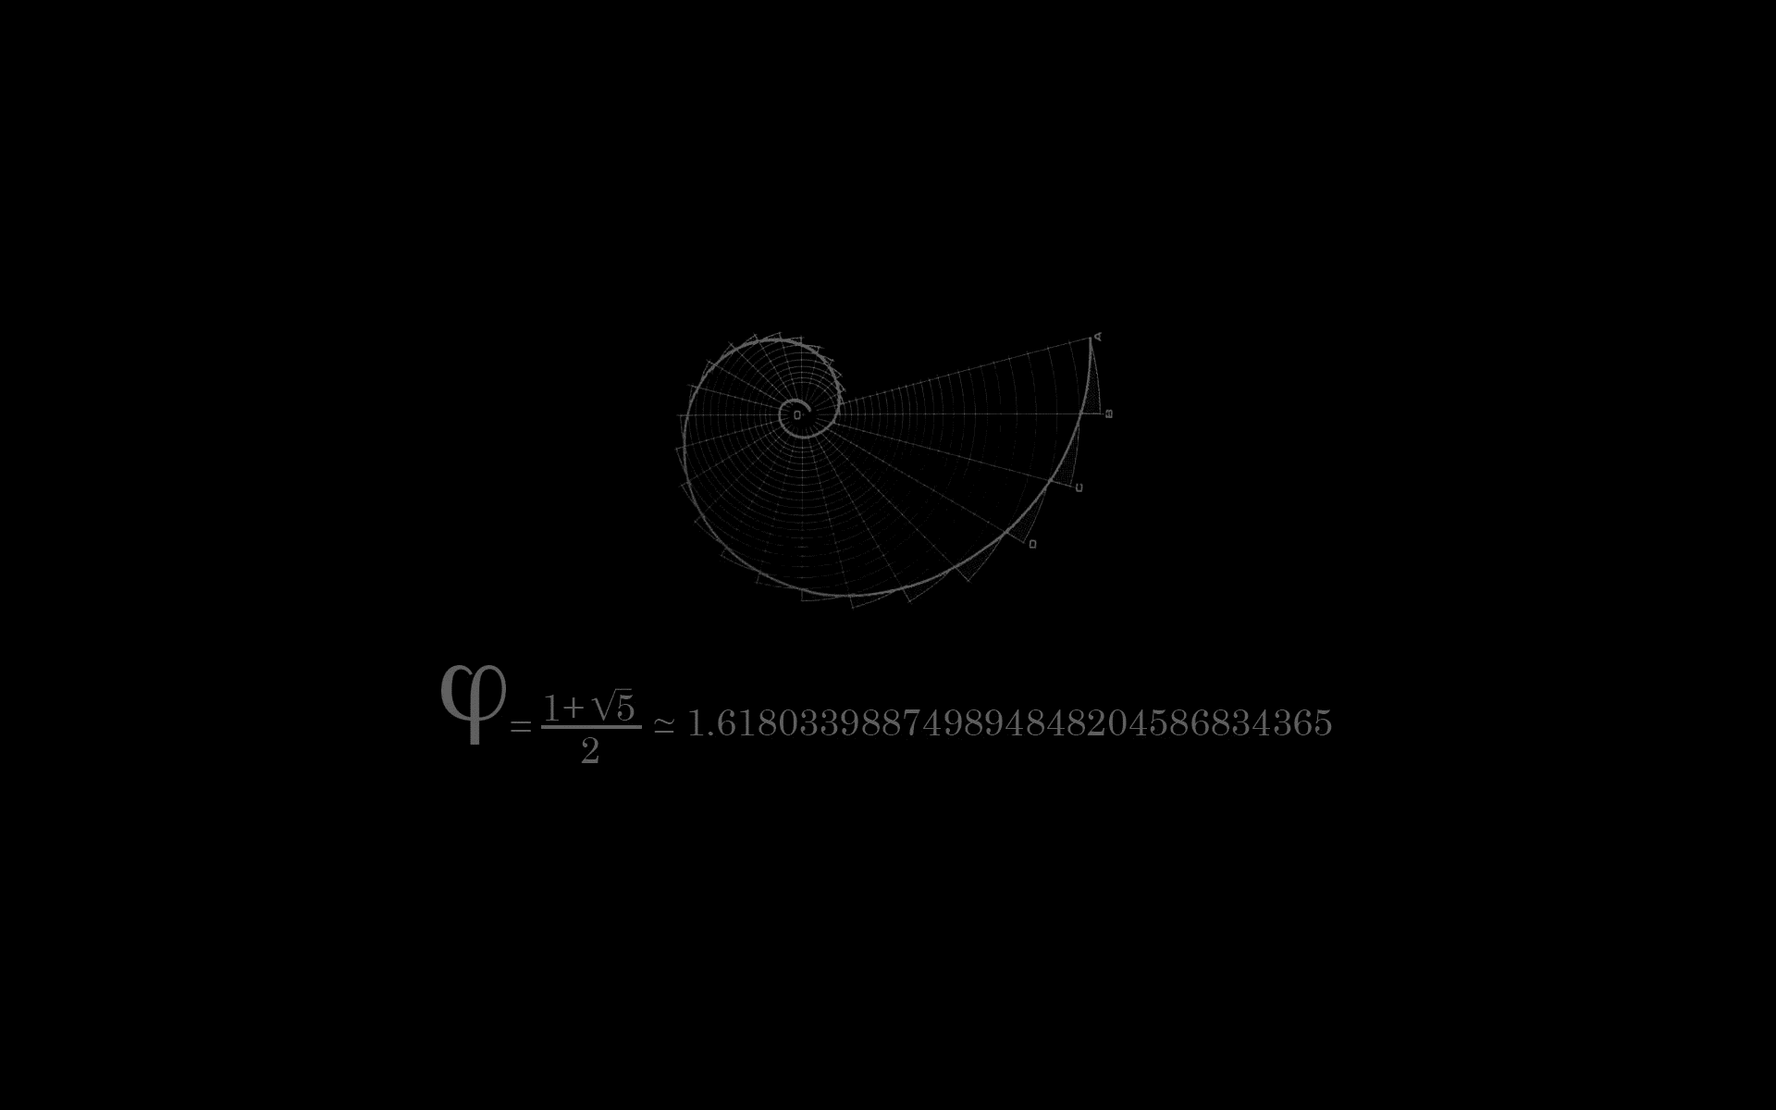
In-Class Exercises
Loop Exercises

Slide 125
In-Class Exercises
Function Exercises

Slide 126
In-Class Exercises
File Manipulation Exercises

Slide 127
In-Class Exercises
Conditional Exercises

Slide 128
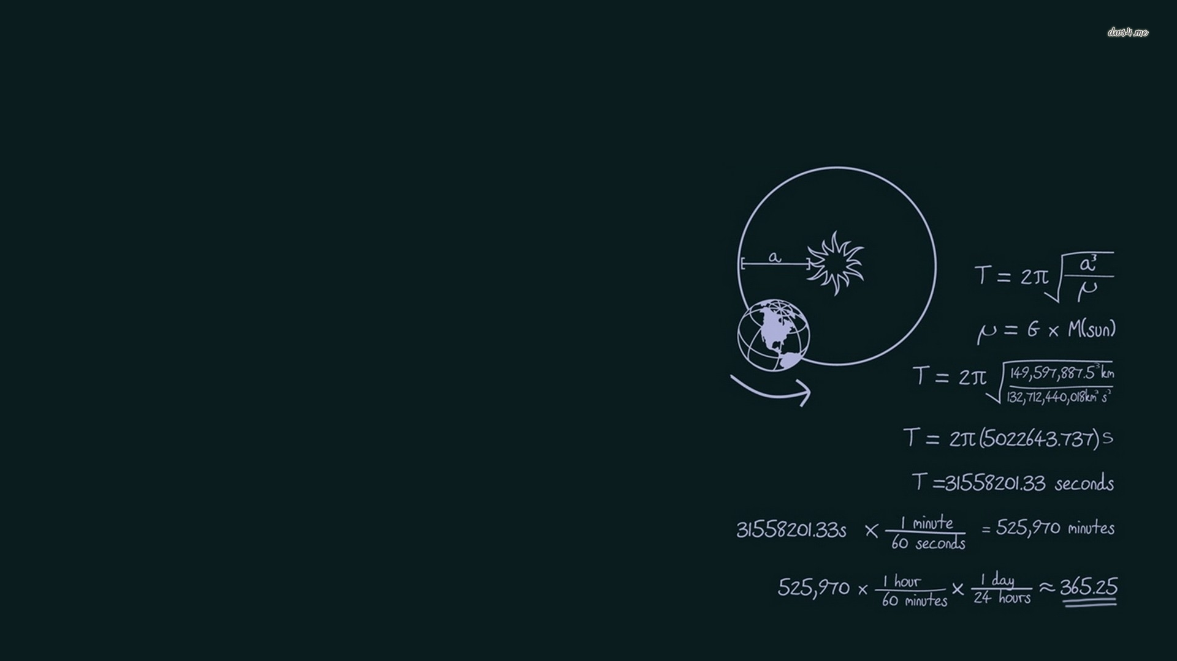
Mini Project
Given a list of part numbers to search and a list of part numbers to find, both in files, find how many

Slide 129

LICENSE
Copyright 2018 Douglas Bowman
Permission is hereby granted, free of charge, to any person obtaining a copy of this software and associated documentation files (the "Software"), to deal in the Software without restriction, including without limitation the rights to use, copy, modify, merge, publish, distribute, sublicense, and/or sell copies of the Software, and to permit persons to whom the Software is furnished to do so, subject to the following conditions:
The above copyright notice and this permission notice shall be included in all copies or substantial portions of the Software.
THE SOFTWARE IS PROVIDED "AS IS", WITHOUT WARRANTY OF ANY KIND, EXPRESS OR IMPLIED, INCLUDING BUT NOT LIMITED TO THE WARRANTIES OF MERCHANTABILITY, FITNESS FOR A PARTICULAR PURPOSE AND NONINFRINGEMENT. IN NO EVENT SHALL THE AUTHORS OR COPYRIGHT HOLDERS BE LIABLE FOR ANY CLAIM, DAMAGES OR OTHER LIABILITY, WHETHER IN AN ACTION OF CONTRACT, TORT OR OTHERWISE, ARISING FROM, OUT OF OR IN CONNECTION WITH THE SOFTWARE OR THE USE OR OTHER DEALINGS IN THE SOFTWARE.

